Slide 1
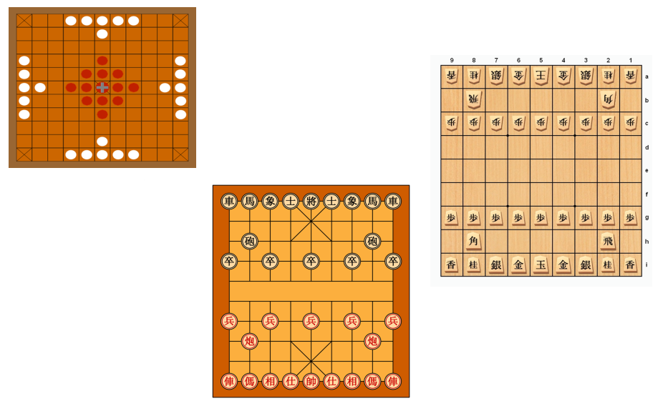
Chess
Not just Chaturanga anymore

Slide 2
Agenda (not hidden)
Introduction
A brief history
Not Covered (today)
What others play (or played)
Hnefatafl (Vikings)
Xiangqi (Chinese Chess)
Shogi (Japanese Chess)
Other chess
Pronunciation
About
Pieces
Rules/Moves/Winning
Variants

Slide 3
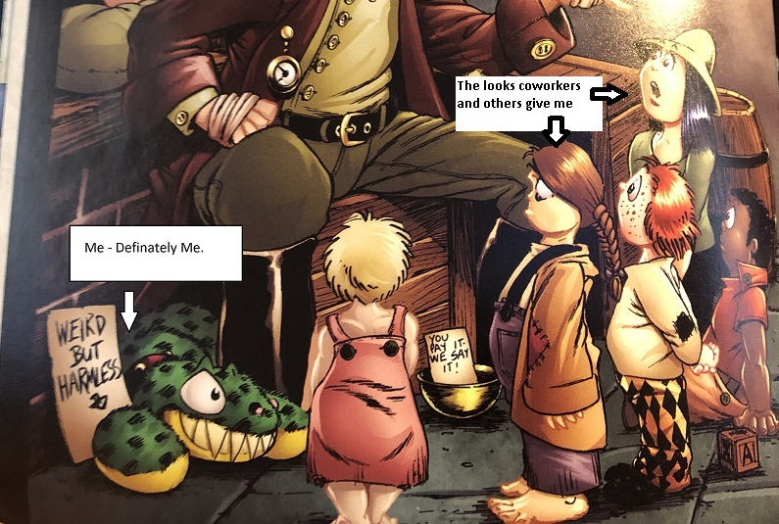
About me (Woody) and caveats
Folio, P., & Folio, K. (Year). Title of the illustration (if any). In Author of the Book (Ed.), Agatha Heterodyne, Girl Genius (p. page number). Publisher.
I enjoy chess (that does not mean I am GOOD at chess)
I am NOT Norse, Chinese, nor Japanese!
Yes, you can get a copy of these slides (GitHub or Thumb Drive)
I have each of these HERE if you want to try. . .
Electronic versions are available on the Apple Store
The internet is your friend
No – this is NOT a standup comedy routine
Folio, P., & Folio, K. (2011). In Agatha Heterodyne and the Beetleburg Clank (Prologue). Airship Entertainment.

Slide 4
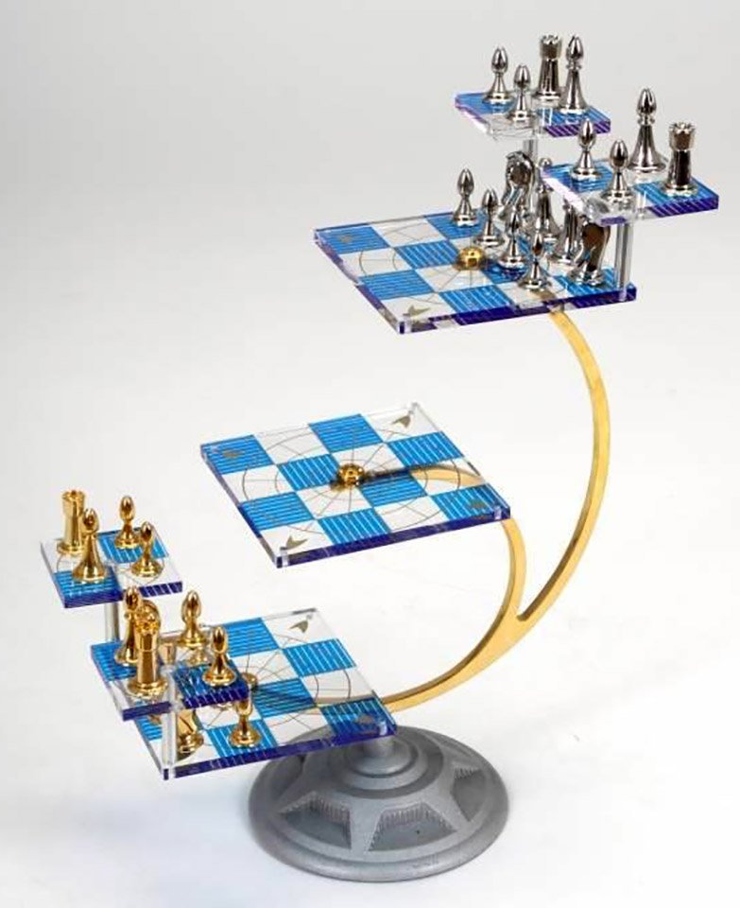
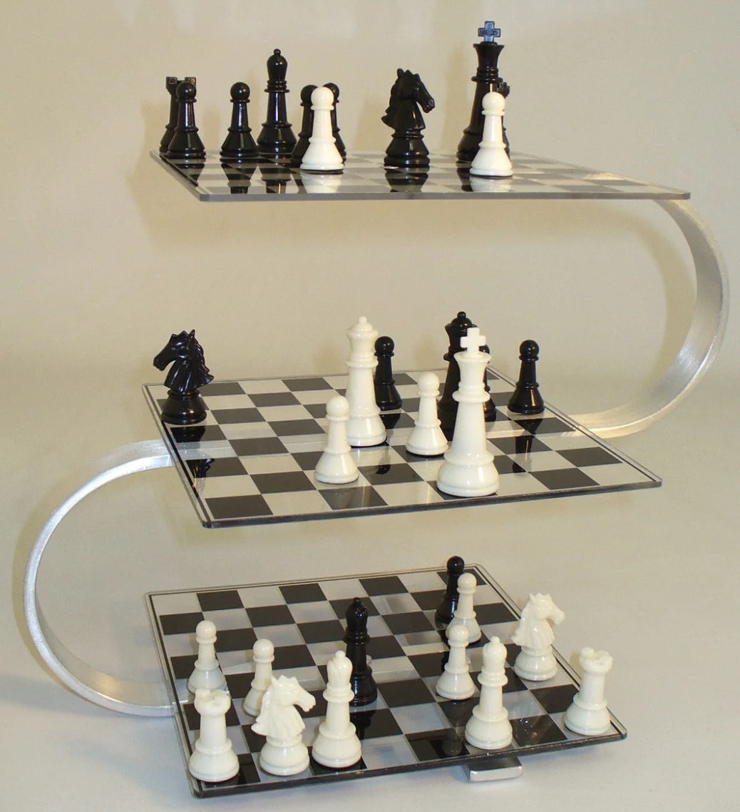
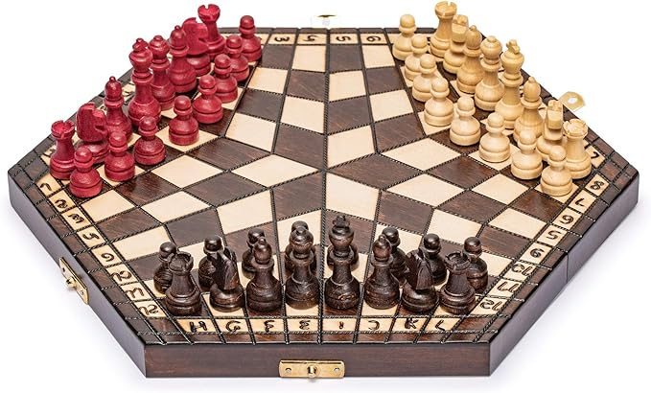
What this is NOT
Star Trek Chess (tri-Dimensional)
Interesting
I have never played
3 Person Chess
I have never played this either
3-d Chess (Strato-3D)
This, I have played

Slide 5
Chaturanga
First (original?) Chess
Viking Chess – evolved from a Roman game
India 7th Century AD (however, possibly 5000 years earlier)
Strategy (my interest in Military History and Military Strategy)
Migrated and evolved
West – Chess, Shatranj (Persian), Chaturaji (4 person), Tamerlane Chess
North – Xiangqi
Some of the limitations on pieces stayed during the north migration (e.g. Elephant only moves 2 spaces, no ‘jumping’)

Slide 6
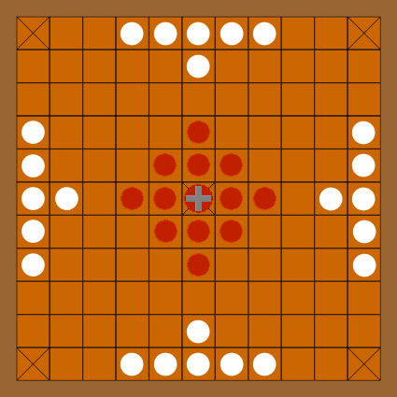
Hnefatafl (Viking Chess – VC)
Pronunciation
About
A number of variants of Tafl games.
Adapted from a Roman Game (Ludus latrunculorum)
4th – 18th centuries, table games in various forms of which Skáktafl (chess) is one)
Modern vs original (rules not written down
Developed differently at different locations. Archaeologists have found editions in places such as Ireland and Ukraine
Board – 11x11
Pieces
King (Defender only)
Pawns (Swedes - Defenders) Around the king
Pawns (Muscovites – Attackers) Edge

Slide 7
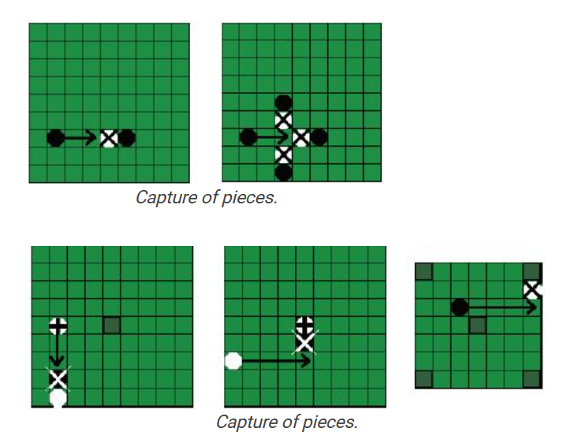
Hnefatafl (Viking Chess – VC)
Rules/Moves/Winning
Pieces (either side) move like the rook in Chess – any number of unoccupied squares
Capturing – one piece on both sides of opposing piece (exceptions on blocked squares)
Goal
King gets to corner
Attackers ‘capture’ king
Variants
Various Tafl games

Slide 8
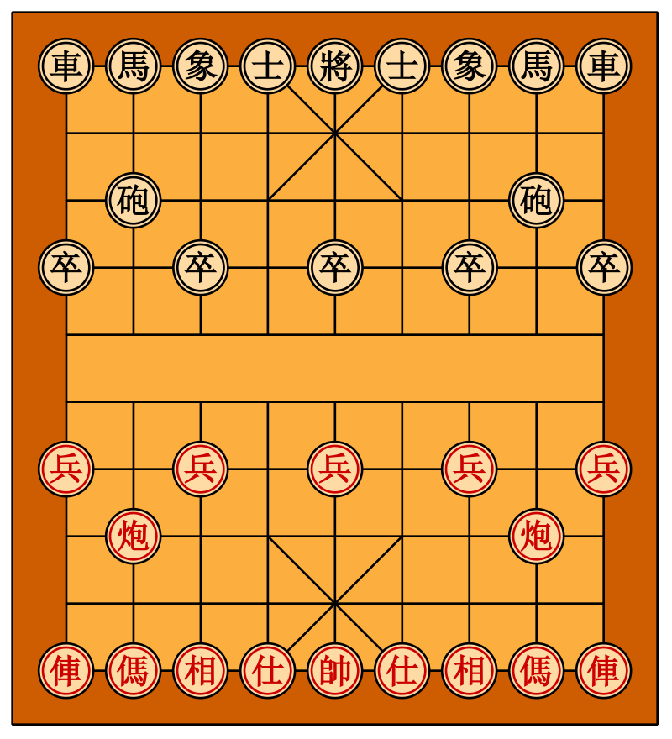
Xiangqi (Chinese Chess – CC)
Pronunciation
About

Slide 9
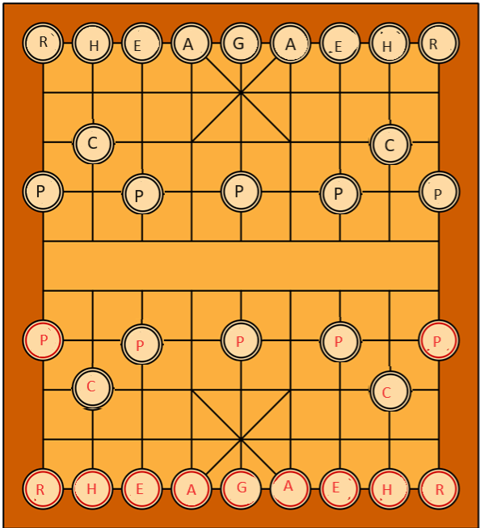
Xiangqi (Chinese Chess – CC)
General (King)
Cannot leave Palace
Cannot ‘see’ the opposing General
1 orthogonally
Advisor (Guards)
Cannot leave the Palace
1 diagonally
Elephant
2 spaces diagonally
‘blocking’ the elephant’s eye

Slide 10
Xiangqi (Chinese Chess – CC)
Horse (Knight)
1 space orthogonally, then 1 space diagonally
‘hobbling the horse’s leg’
Chariot (Rook)
Similar to rook in chess – orthogonally, no jumping
Cannon
Moves like Chariot,
To capture MUST jump an intervening piece
Soldier
One space forward
Once across river . . .

Slide 11
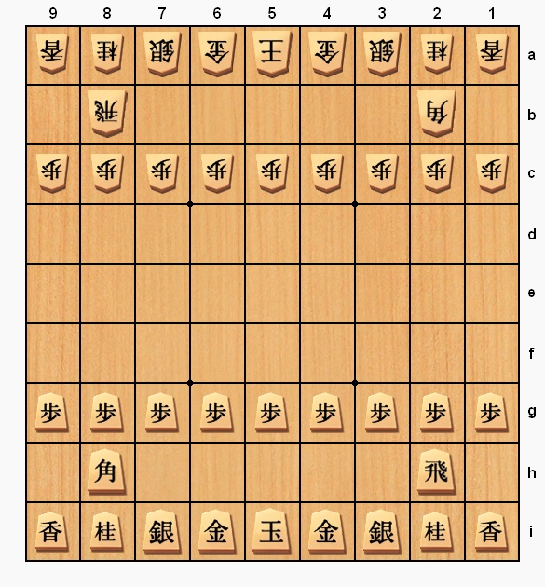
Shogi
Pronunciation
About
Pieces
Rules/Moves/Winning
Variants

Slide 12
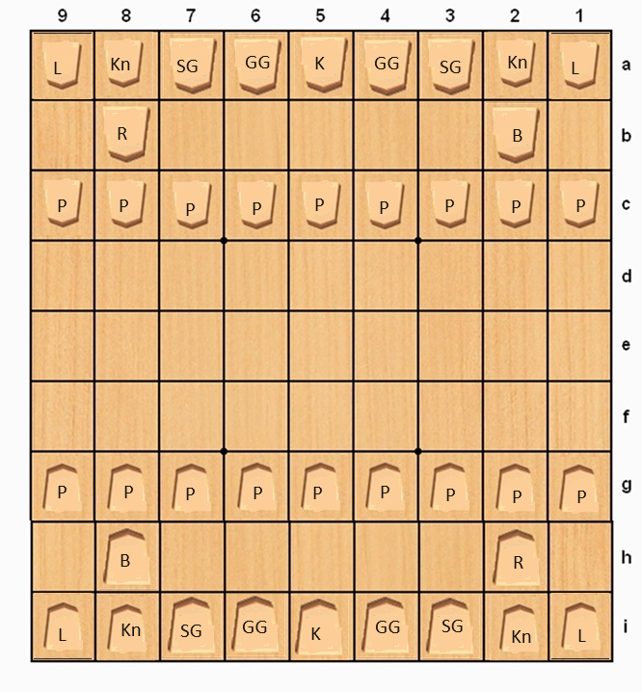
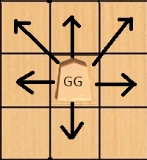
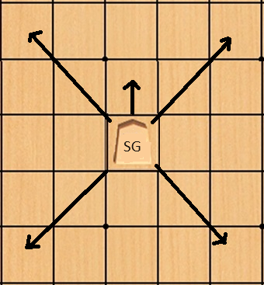
Shogi
Pieces (Moves, Promotion)
King
1 Space, any direction
Cannot be promoted ☹
Gold General (x2)
Cannot be promoted
1 Step at a time
Silver General (x2)
1 step forward
Any number diagonally
Promotes to Gold General

Slide 13
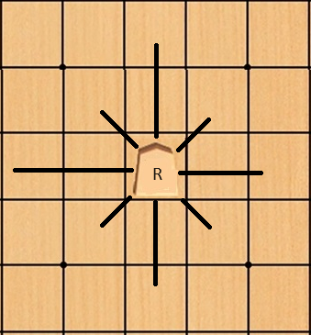
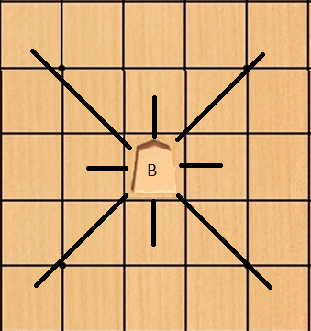
Shogi
Pieces (Moves, Promotion)
Rook (x1)
Unlimited, Horizontal/Vertical
Promotes to Dragon (adds
1 space diagonally)
Bishop (x1)
Unlimited Diagonally
Promotes to Horse
(adds 1 space
Horizontal/Vertical)

Slide 14
Shogi
Pieces (Moves, Promotion)
Knight (x2)
2 Steps Forward, 1 Step to either side
Can jump
Note – steps FORWARD
Promoted Knight moves like Gold General
Lance (x2)
Unlimited Vertically forward
Promoted Lance moves like Gold General

Slide 15
Shogi
Pieces (Moves, Promotion)
Pawn (x9)
1 Step Forward
Captures forward
Promoted Pawn moves like Gold General

Slide 16
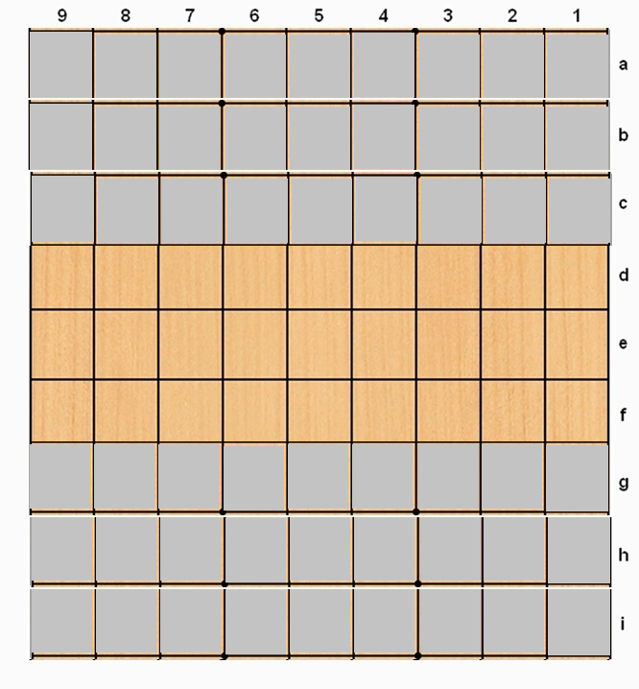
Shogi
Pieces (Promotion, Captures)
Promotion
Last 3 ranks in YOUR direction of motion
Promotion is voluntary
Captures
During your turn, you may ‘drop’ (place) a piece YOU captured on the board
Dropped pieces are the unpromoted piece
Can drop in the promotion zone (and promote next turn
Cannot drop Knight where it cannot move (e.g. last rank)

Slide 17
Variants
Hnefatafl
Xiangqi
Janggi (Korean Chess – no river)
Game of the three Kingdoms
Chess
Hexagonal Chess
Chaturaji (4 person Chess)

Slide 18
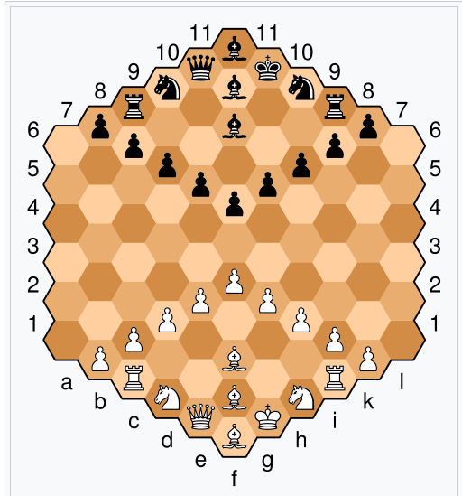
Hexagonal Chess
Glinski Variant
Additional Pawn and Additional Bishop
Bishops move ‘diagonally’ along the same colored tiles.
No en passant

Slide 19
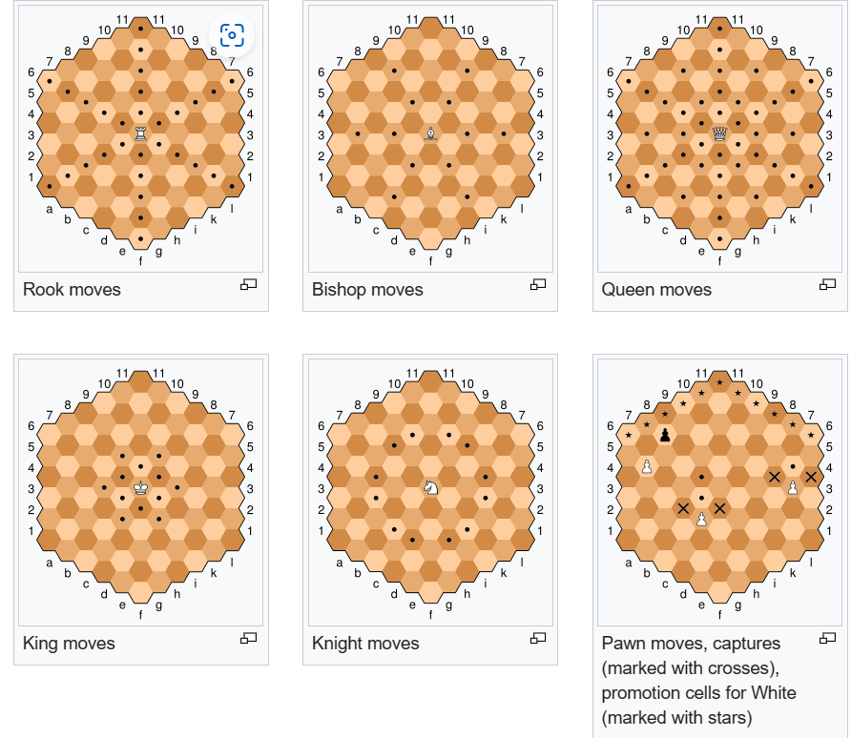
Hexagonal Chess

Slide 20
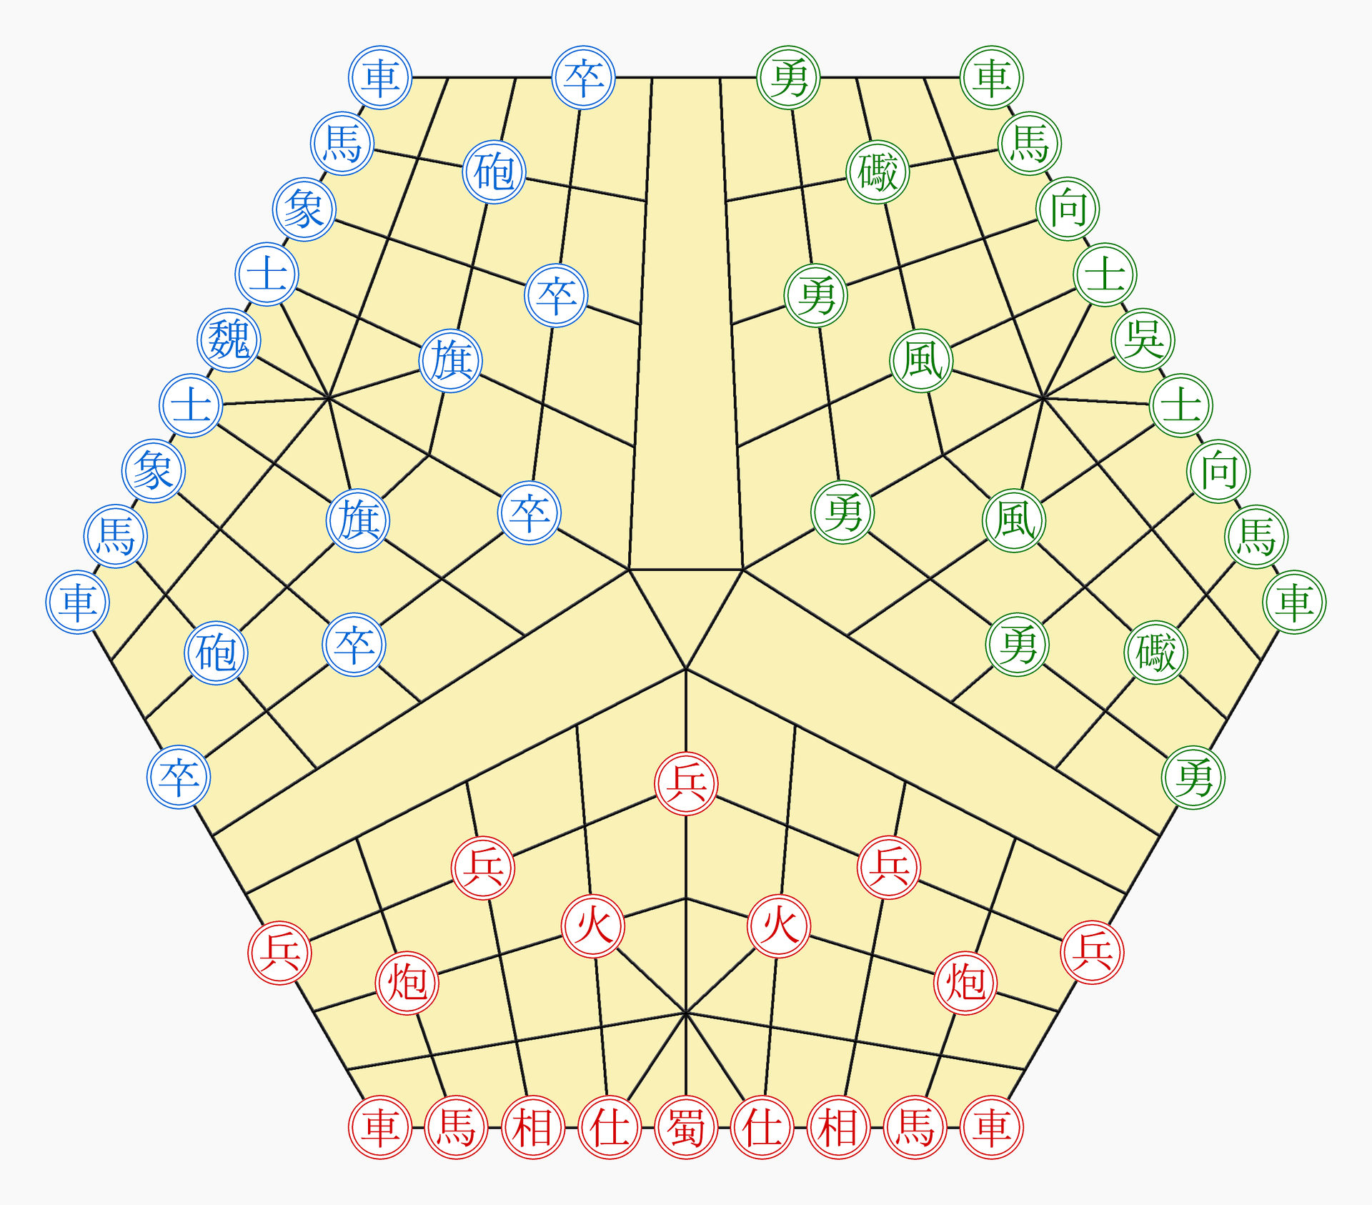
Game of Three Kingdoms
About
From the Waring States Period
Red, Green, Blue pieces
The side that ‘defeats one of the others takes over the remaining pieces
Pieces
Same as Chinese Chess

Slide 21
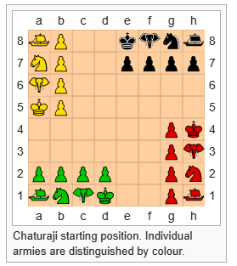
Chaturaji

Slide 22
References
Books
Shogi - Japanese Chess (by Mountain, Yellow)
Shogi Primer: Japanese chess guide for English speakers ISBN 979-8-7552-5331-4
Xiangqi For Absolute Beginners ISBN 9789671436219
Xiangqi or Chinese Chess Book of Board Game Strategy ISBN 979-8-501-16897-8
An Introduction to Hnefatafl ISBN 978-1-326-37233-0

Slide 23
References
Links
Hexagonal Chess Hexagonal chess – Wikipedia
Tafl games – Wikipedia
The Rules Of Hnefatafl: Learn To Play “Viking Chess” – Let's Play Hnefatafl! (letsplayhnefatafl.com)
Shogi – Wikipedia
https://ocfchess.org/chaturanga/
Chaturanga – Wikipedia
Waldkopf/Chess: Presentation on 'other' forms of chess (Viking, Chinese, Japanese) (github.com/Waldkopf/chess)

